Slide 1
MGMT590 - Visual Analytics
Session 4
Dr. Cecilia Ying
Updated: 09/09/2025

Slide 2
Today’s Agenda
Session 4
Special graphs “show and tell”
Recap from last week’s Titanic exercise
Design Principles for Visual Analytics
Project 1 walk-through
Assignment 1 working session

Slide 3

Special Graph “Show and tell”

Slide 4
Week 2 Recap
Hands-on Exercise on Titanic Dataset

Slide 5
What did we “learn”?
In class hands-on exercise
Data (especially in real life) is never perfect
Contains missing/ incorrect data
Never gives us exactly what we need
How to group a “family” unit depends on the assumptions and logic we used
Everyone can get a different answer
There are a lot of Andersons on the Titanic
Generating graphs and working with data in Colab is not that hard
Our super human brains are still the most important!
(we make the decisions)

Slide 6
Design Principles for Visual Analytics
Parsons, P. (2022).
Understanding data visualization design practice.
IEEE Transactions on Visualization and Computer Graphics, 28(1), 665-675.

Slide 7
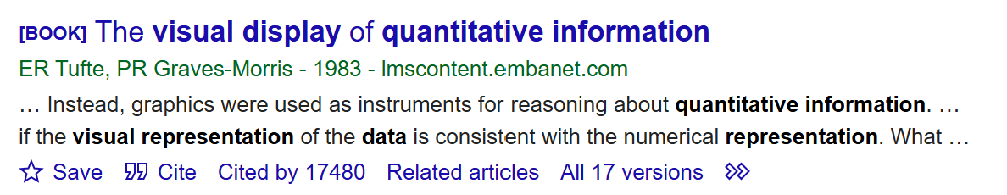
Designs for the Display of Information
Edward R. Tufte
Design is a choice.
The theory of the visual display of quantitative information consists of principles that generate design options and that guide choices among options… Most principles of design should be greeted with some skepticism, for word authority can dominate our vision, and we may come to see only through the lenses of word authority rather than with our own eyes.
What is to be sought in designs for the display of information is the clear portrayal of complexity. Not the complication of the simple; rather, the task of the designer is to give visual access to the subtle and the difficult – that is,
The revelation of the complex.

Slide 8

Dr. Edward Tufte – Yale University
https://www.edwardtufte.com/books/
“If you see a pie chart projected 12 feet high in front of you, you know you’re in the hands of an idiot.”

Slide 9
Understanding Data Visualization Design Practice
Paul Parsons (2021)
Context
There is a knowledge gap around how data visualization design is generated through academic research and how this can be applied in practice.
In this paper,
Surveyed 87 data visualization practitioners for their understanding of popular design methods and frequency of use in practice
Interviewed 20 data visualization practitioners for their design process, strategies, and use of methods and concepts that guide their practice.

Slide 10
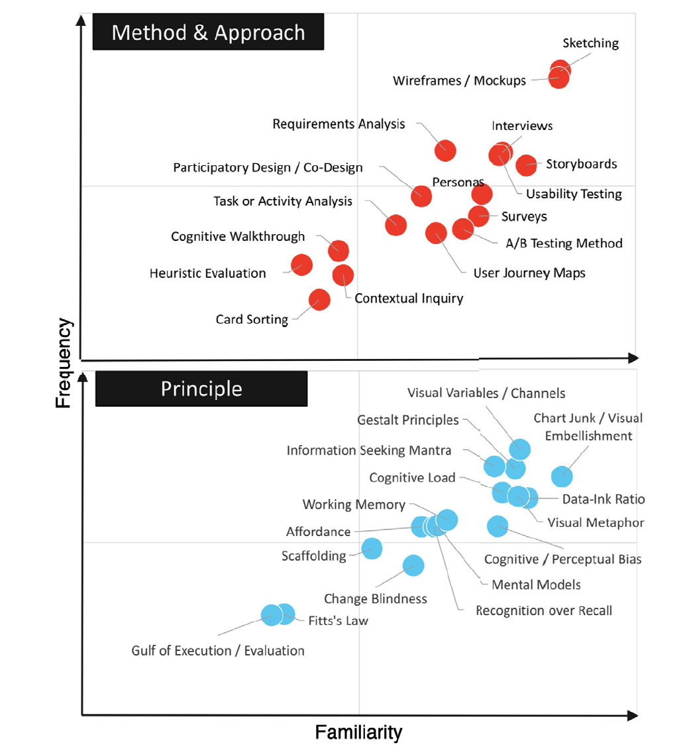



Familiarity and Frequency of Use
Of Popular Design Methods and Principles
The disconnect (between theory and practice) is REAL!
Fitt’s Law:
the larger and closer a target is, the faster and easier it is to select, while smaller and farther targets require more time and effort

Slide 11
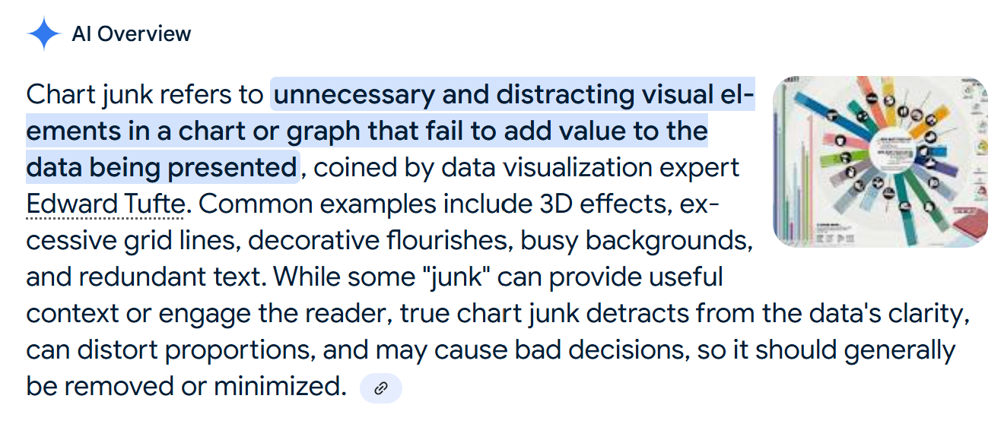
Part 1: Key findings from the survey
Most familiar and frequently used
Methods: Sketching and wireframing/mockups were significantly more familiar and used than other methods
Principle: On average, the most familiar principle was chart junk

Slide 12
Part 2: Interviews with practitioners
Questions including
How do practitioners engage in their design processes, and what strategies do they use?
How do practitioners start their design process?
When working through a design process, how do practitioners assess their progress, including how to determine if they are on the right track and what steps to take next?’
What is the structure of the process, e.g., is it systematic, logical, step-wise, iterative, or linear?
How do practitioners make decisions regarding which chart types and visual encodings to use within their process?
How are various forms of design knowledge used in practitioners’ design practice?
Do they rely on any high-level theory to guide their design work?
How are methods and principles used in their design work?
Are there methods and principles that are more useful than others?
Are they aware of the history and development of popular visualization design concepts?

Slide 13
2.1 Key Findings: Design process and strategies
Data, Users, or Clients First
1. Data, Users, or Clients First?
2. Assessing Progress
3. Planning in Action
Start the process by trying to
Understand the data
Understand the users’ needs/ clients’ goals
Visually represent the data for problem framing
Experimentation & in the moment
Just to get a “feel” for things
Tacit knowledge from experience
“intuition” or “gut feeling”
Involving others in evaluation
Test with users

Slide 14
2.2 Key Findings: Design knowledge
Simplify and clarify using visualization
Design theories/ principles, methods, and guidelines: i.e., Design Activity Framework, Nested Model, Design Study Methodology, affordance, data-ink ratio, cognitive load, data types, Gestalt principles, chartjunk, visual variables, and mental models etc.
Readability vs. Usability:
Keep the client engaged
Goal: Simplify and Clarify
Scientific Knowledge
Choosing Chart Types
For example: Perceptual rankings
People are better at comparing lines than they are at angles

Slide 15
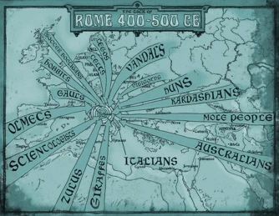
Methods and Principles in Practice
All roads lead to Rome
All roads lead to Rome.
Experience is more important than knowledge of theories/ principles

Slide 16
Team Project
Building your “killer figure”

Slide 17
Team Project Description
Building your “killer figure”
Context
You are pitching a business case to a group of senior technology executives at your company, but a call came in, and the CTO will have to leave the meeting in 5 minutes.

Slide 18
Team Project Description
Building your “killer figure”
Challenge
You have 5 minutes to summarize your key findings, assumptions, and/or projections to convince your CTO that YOUR project is worth funding.

Slide 19

Ryan Buell’s famous “Killer Figure”
Professor from Harvard Business School https://www.hbs.edu/faculty/Pages/profile.aspx?facId=320524
“You should be able to summarize your entire presentation using ONE KILLER FIGURE.”

Slide 20
Team Project Description
Building your “killer figure”
Your Tasks
Identify a domain that is interesting to your team.
Find a dataset in that domain (common places to look: HuggingFace, Kaggle, UCI, Papers with Code)
Craft a project idea based on the data you are using (more on the next slide)
Create one killer figure that clearly tells your story
5-minute in-class presentation using the killer figure

Slide 21
Team Project Description
Building your “killer figure”
Project Objectives
Crafting a compelling story with data
Clearly articulate that story with one killer figure
Be creative and have fun

Slide 22
Team Project Description
Building your “killer figure”
Crafting Your Idea
What problems are you trying to solve?
What questions are you trying to answer?
What kind of data will you need?

Slide 23
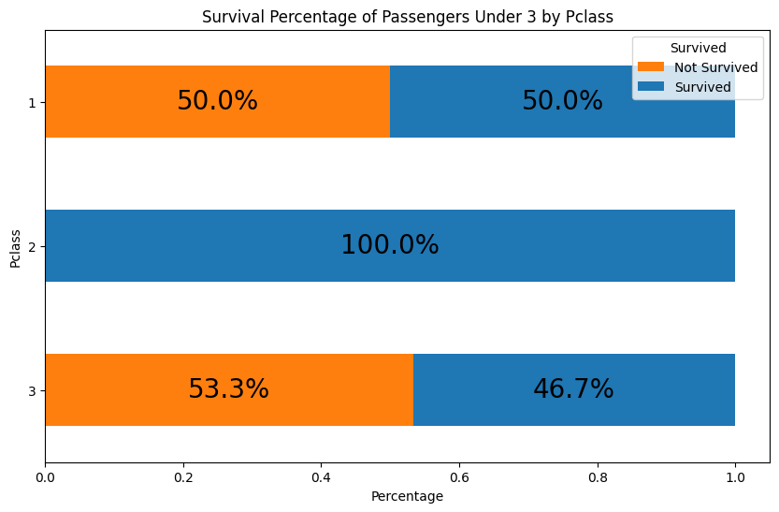
Team Project Description
Building your “killer figure”
Punchline:
The first-class children have only a slightly higher survival percentage (50%) than the third-class children (46.7%)!

Slide 24
Team Project Description
Building your “killer figure”
The first-class children pay, on average $151, which is 6 times higher than third-class children, who pay, on average $23. And yet, the company failed to ensure their safety.
Business proposal to
Improve the overall survival percentage for all children.

Slide 25
Team Project Description
Building your “killer figure”
Watch this video for inspiration (as needed)
How Consulting Firms Make Complex Topics Simple
Analyst Academy

Slide 26
Common Data Sources
Some recommendations
Huggingface: https://huggingface.co/docs/datasets/en/index
Kaggle: https://www.kaggle.com/datasets (Here you will also easily find code/notebooks from others, but be careful when using someone else's code - it might take more time to debug than write your own)
UCI: https://archive.ics.uci.edu/datasets
Papers with code: https://paperswithcode.com/datasets (this one is great if you want to read the research that's been done on the particular dataset)

Slide 27
How to use Power BI, Tableau, Excel/ VBA, Python, R…
Course objectives & preferred tools
Course objectives: Who, What, When, Where…
Exercising your managerial muscles
Focus on the story behind the data
You are free to use whatever graphical tools you are most familiar with (this course is not about the HOW)
Special Workshops during TA office hours on Tuesdays.

Slide 28

Questions?

Slide 29
Assignment 1
Working Session

Slide 30

Questions?

Slide 31

That’s a wrap

Slide 32
Course Schedule
At a glance

Slide 33
Assignment 1
Titanic – who will survive?

Slide 34
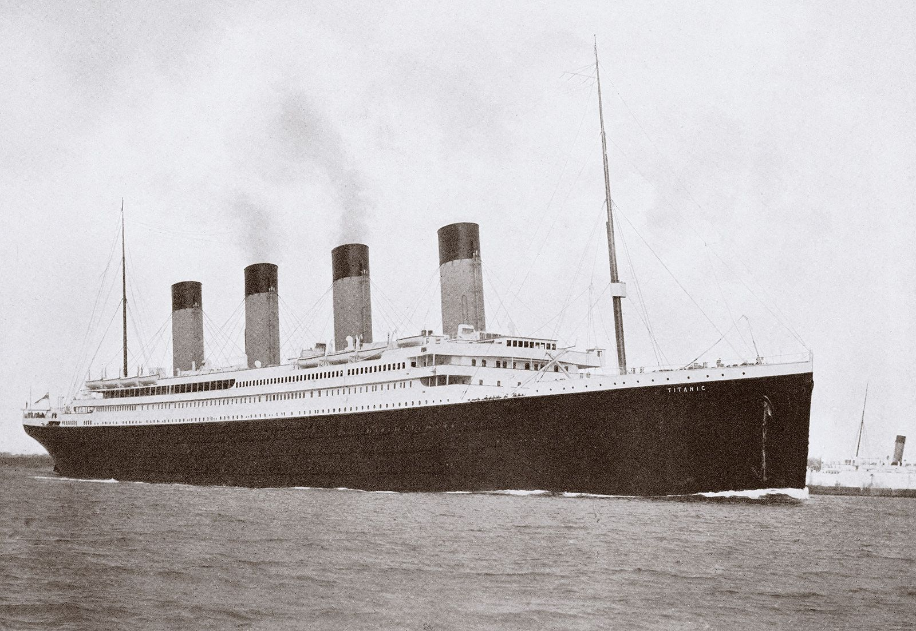
Titanic
Finding insights from the data
Data Understanding & Preparation
Assess the quality of the data
Create a plan to address (through data engineering)
Potentially incorrect data
Missing data
Collection of additional data that might be useful
Decision-making
Given the data you have and the understanding of who is more likely to survive, what else could be done to improve the survival rate?
Obviously, other than “adding more lifeboats”

Slide 35
Team Project
Team set up and project brainstorming

Slide 36
Team Project
First, create a group
4-5 people
Select a cool team name
Enroll yourself in the group on Brightspace
Brainstorm
What problems are you trying to solve?
What questions are you trying to answer?
What kind of data will you need?
Do this by
Sept. 7th

